Slide 1





Trends in Skills Set Requirement among Software Developers
George Mathew
16th May 2023

Slide 2


OUTLINE
Executive Summary
Introduction
Methodology
Results
Visualization – Charts
Dashboard
Discussion
Findings & Implications
Conclusion
Appendix
Disclaimer: As the data used for the project is a part (1/6th) of the survey data, hence the results may vary from the original results of the survey available in https://insights.stackoverflow.com/survey/2020

Slide 3
EXECUTIVE SUMMARY
My organization regularly analyses data to help identify future skill requirements. For that we collect the top technology skills that are most in demand from various sources including:
Job postings
Training portals
Surveys
The prepared data following data wrangling is analysed using statistical techniques and visualization of charts and interactive dashboards. The exercise is undertaken keeping in mind our objective to find out the answers to the following problems.
What are the top programming languages that are in demand ?
What are the top database skills that are in demand ?
What are the most popular Platforms ?
Demographic data like gender and age distribution of developers.

Slide 4
EXECUTIVE SUMMARY
The answers that were found to the problems based on the exercise are :
The top ten programming languages in descending order are : JavaScript, HTML/CSS, TypeScript, SQL, Python, C#, Go, Bash/Shell/PowerShell, Rust, Java
The top ten databases in descending order are : PostgreSQL, Redis, MongoDB, Elasticsearch, MySQL, Microsoft SQL Server, SQLite, Firebase, MariaDB, DynamoDB
The top ten Platforms in descending order are : Docker, Linux, AWS, Kubernetes, Windows, Microsoft Azure, Google Cloud Platform, MacOS, Android, iOS.
The demographic data based on the survey shows that almost 90% of the respondents in the survey were men and the maximum developers were in the age group 25 to 35.
The exercise has resulted in identifying the future skill requirements which will help :
The developers add the required skill set to their existing skills and remain relevant in the competition
The employers to guide and support their existing developers to reskill themselves as also to align the training infrastructure of the employers and training organisations.

Slide 5
INTRODUCTION
I have joined as a Data Analyst in a global IT and business consulting services firm that is known for their expertise in IT solutions and has a team of highly experienced IT consultants. To keep pace with changing technologies and remain competitive, my organization regularly analyzes data to help identify future skill requirements.
The business challenge before me requires collecting data and performing data analysis on real-world datasets identifying trends for this year's report on emerging skills
The various sources for collecting data include :
>> Job postings >> Training portals >> Surveys
Prepare the collected data for analysis by using data wrangling techniques like, finding duplicates, removing duplicates, finding missing values, and inputting missing values.
Apply statistical techniques to analyze the data and identify insights and trends.
Choose an appropriate visualization based on the data and make a presentation using charts, plots, and histograms to help reveal the findings and trends and use interactive dashboards to help analyze and present the data dynamically with analysis report and an executive summary to the various stakeholders in the organization.
This report will come handy to the developers as the identification of future skill requirements which will help them add the required skill set to their existing skills and remain relevant in the competition.
The report will act as a guide to employers / organisations to support their existing developers to reskill themselves and align the training infrastructure of the employers and training organisations.

Slide 6
METHODOLOGY
We will begin by scraping internet web sites and accessing APIs to collect data in various formats like .csv files, excel sheets, and databases. The source of data is the stackoverflow survey of 2020 available in https://insights.stackoverflow.com/survey/2020.
Once this is completed, the next step is to get the data ready for analysis using data wrangling techniques.
As the quest of the organisation is to identify the future skill requirements, the problems for which we need to find answers are :
What are the top programming languages that are in demand ?
What are the top database skills that are in demand ?
What are the most popular Platforms ?
Demographic data like gender and age distribution of developers.
So, when the data is ready, we will apply statistical techniques to analyze the data.
Then bring all the information together by using charts, plots, histograms as also use IBM Cognos Analytics to create the dashboard and prepare the presentation.

Slide 7
RESULTS
The results of various statistical and visualisation methods used are listed as under:
Data wrangling – Removing duplicates / Removing or replacing Null values /Normalising compensation
The Language names are classified as Difficult, Hard and Easy with ’Go’ being the difficult, ‘C#’, ‘C++’ and ‘R’ being Hard while ‘Python’, ‘Java’, ‘Javascript’, ‘Swift’ ‘PHP’ and ‘SQL’ fall under the Easy category. (Appendix – Fig -1)
The lowest average salary is for those with skills in PHP and SQL and the highest is for Swift, followed by Python, C++, JavaScript, Java, Go, R and C# in the descending order. (Appendix – Fig -1)
Exploratory Data Analysis – Summary of charts plotted and why used​
The frequency distribution chart shows a normal distribution curve for salary based on the language skills with a low sigma value depicting narrow distribution as far as the salary for different language skills is concerned. (Appendix – Fig - 2)
The Histogram shows that while one bin has a frequency of 9600 (approx.) other ten bins have a very low frequency ranging upto 200. (Appendix – Fig - 3)

Slide 8
RESULTS (contd/-)
Exploratory Data Analysis - Summary of charts plotted and why used​ (contd/-)
The median converted compensation in USD is 57745 (Appendix – Fig - 4)
The gender distribution shows 10480 men and 731 women (Appendix – Fig - 5)
The median converted compensation in USD for men is 57744 and for women 57708 (Appendix – Fig - 6)
The mean age is 30.78 (Appendix – Fig - 7)
The histogram of Age shows maximum (5500) respondents within the age group of 25 to 35 with drastic reduction after the age of 40 (Appendix – Fig - 8)
The outliers for converted compensation is negligible. (Appendix – Fig - 9)
The highest correlation of Age is with converted compensation of 0.40 with the next highest correlation being 0.09 of Age with CodeRevHrs (Appendix – Fig - 10)
Data Visualisation - Summary thereof and why used​
There are outliers above Q3 (towards the last quartile) as far as column Age is concerned (Appendix – Fig - 11)

Slide 9
RESULTS (contd/-)
Data Visualisation - Summary thereof and why used​
The scatter plot of Age and WorkWeekHours makes identification of correlation difficult (Appendix – Fig - 12)
The bubble plot of Age and WorkWeekHours makes identification of correlation difficult (Appendix – Fig - 13)
The highest respondents for the survey were from United States (52%) followed by United Kingdom (15%) (Appendix – Fig - 14)
The maximum respondents (4500 approx.) were developers by profession (Appendix – Fig - 15)
Dashboard Using IBM Cognos Analytics
Results from three interactive dashboards showing trends in the required skill set
Dashboard Tab 1 – Current Technology Usage – (Slide – 17)
The top programming languages during the current year are JavaScript, HTML/CSS, SQL in the descending order.

Slide 10
RESULTS (contd/-)
Dashboard Using IBM Cognos Analytics
Dashboard Tab 1 – Current Technology Usage (contd/-)
The top databases during the current year are MySQL, PostgreSQL, Microsoft SQL Server in the descending order
The top platforms during the current year are Windows, Linux, Docker, AWS, MacOS in the descending order
The top New Collab Tools during the current year are GitHub, Stack, Google Suite, Jira in the descending order
Dashboard Tab 2 – Future Technology Trend - (Slide – 18)
The top programming languages during the next year are JavaScript, HTML/CSS, Typescript, SQL in the descending order
The top databases during the next year are PostgreSQL, Redis, MongoDB in the descending order
The hierarchy of platforms during the next year are Docker, Linux, AWS, Kubernotes in the descending order

Slide 11
RESULTS (contd/-)
Dashboard Using IBM Cognos Analytics
Dashboard Tab 2 – Future Technology Trend (contd/-)
The top New Collab Tools during the next year are GitHub, Stack, Google Suite, Jira in the descending order
Dashboard Tab 3 – Demographics - (Slide – 19)
The distribution of respondents to the survey was 96% men and 4% women
The maximum respondents to the survey were from United States of America followed by United Kingdom, Germany, India in descending order
The respondents were mainly in the Age group 22 to 41 and the maximum respondents had an Age of 29
The education level of maximum of the respondents was graduate followed by masters

Slide 12
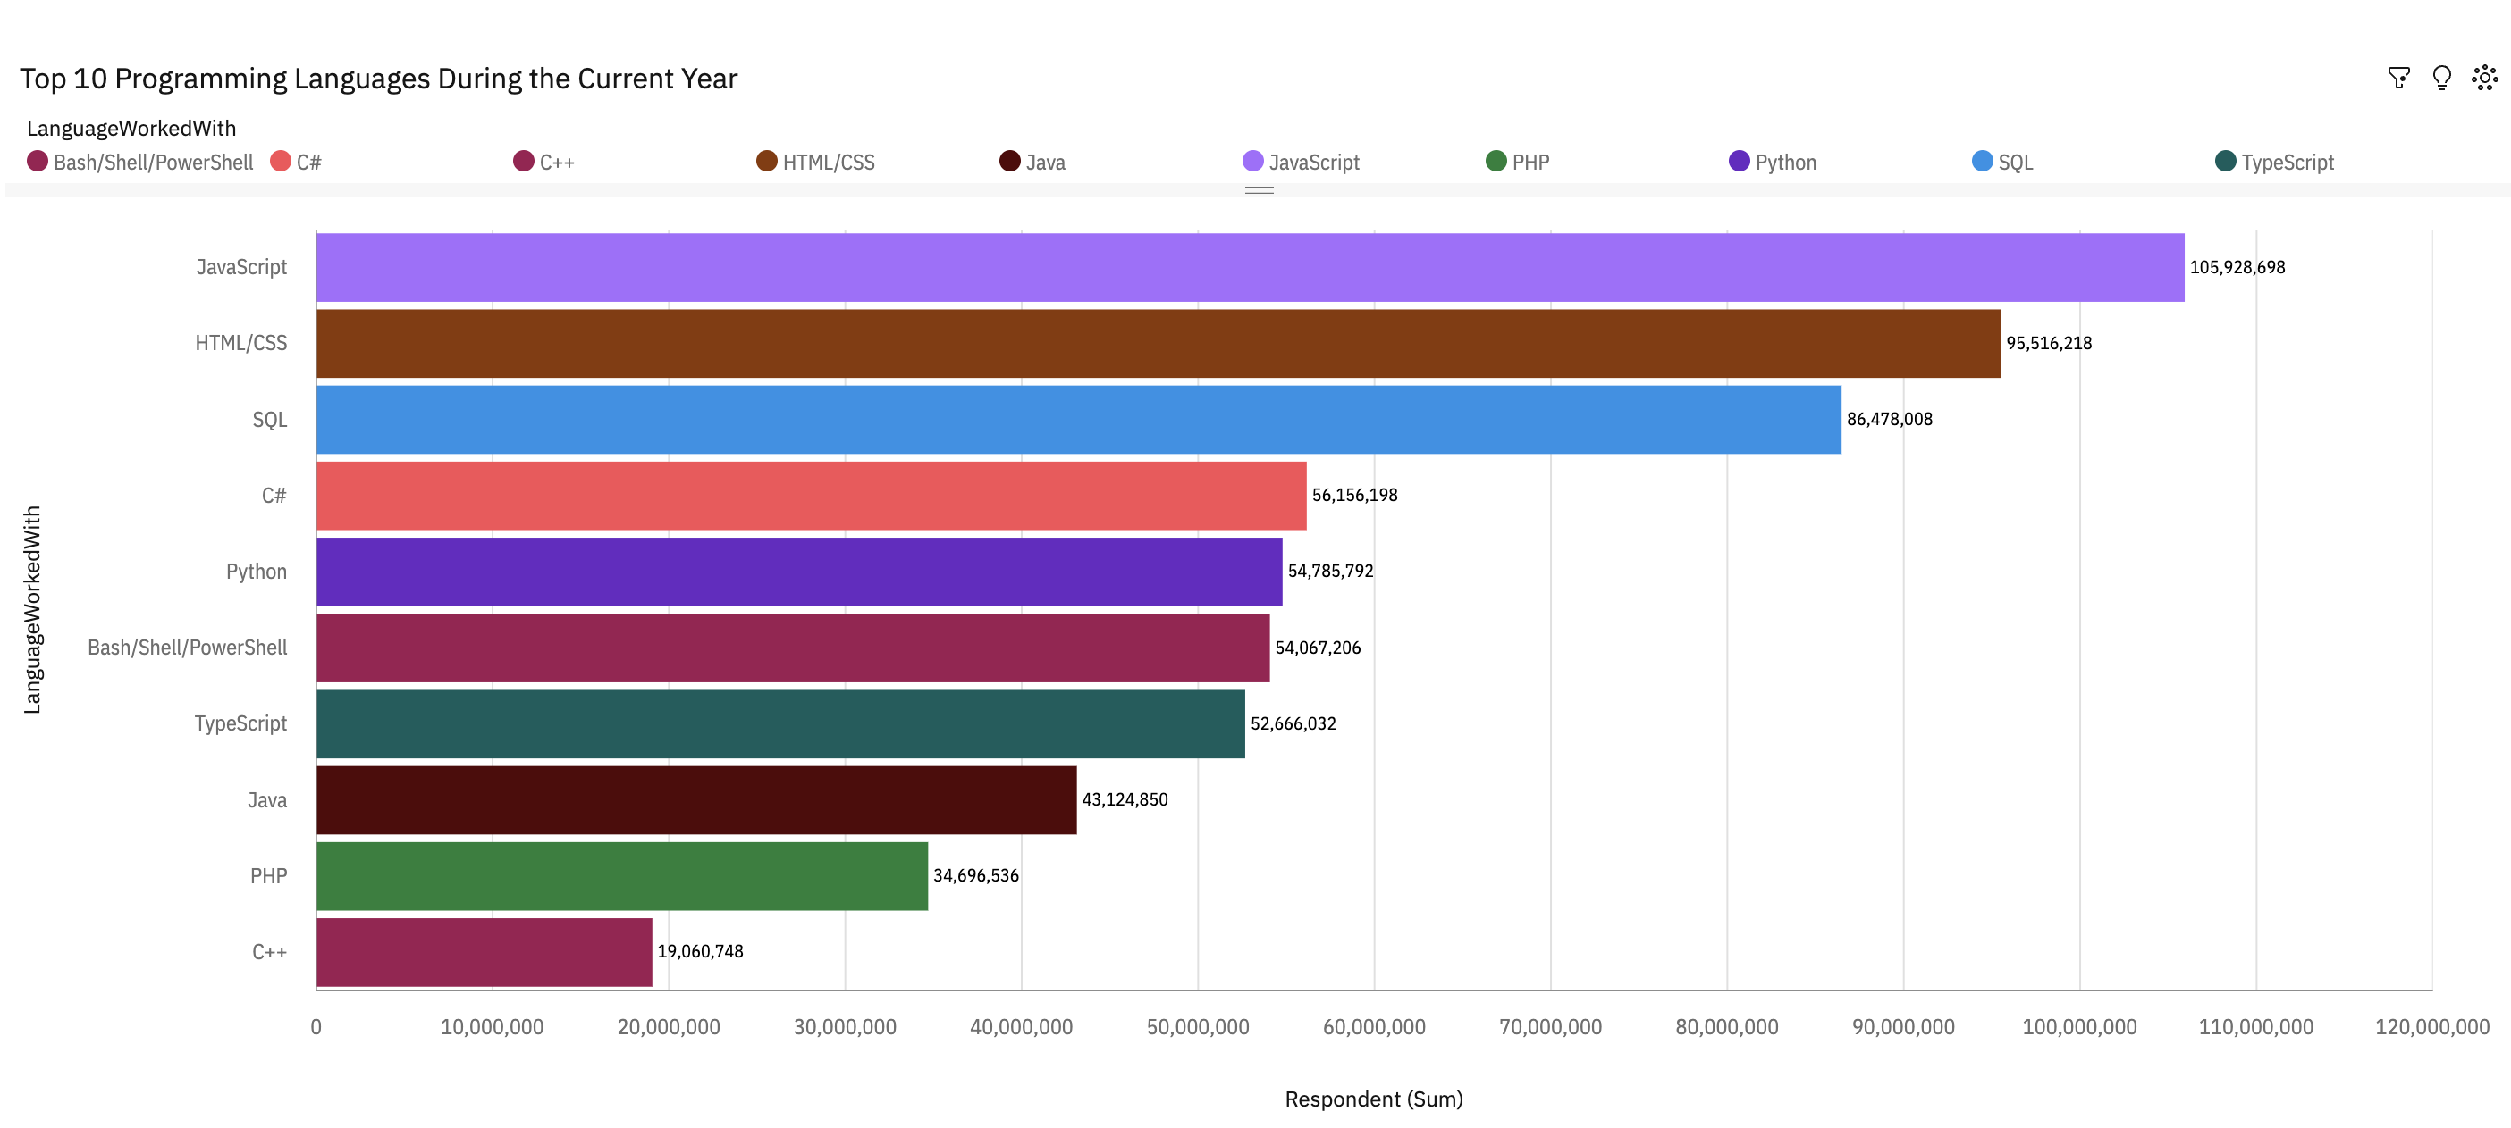
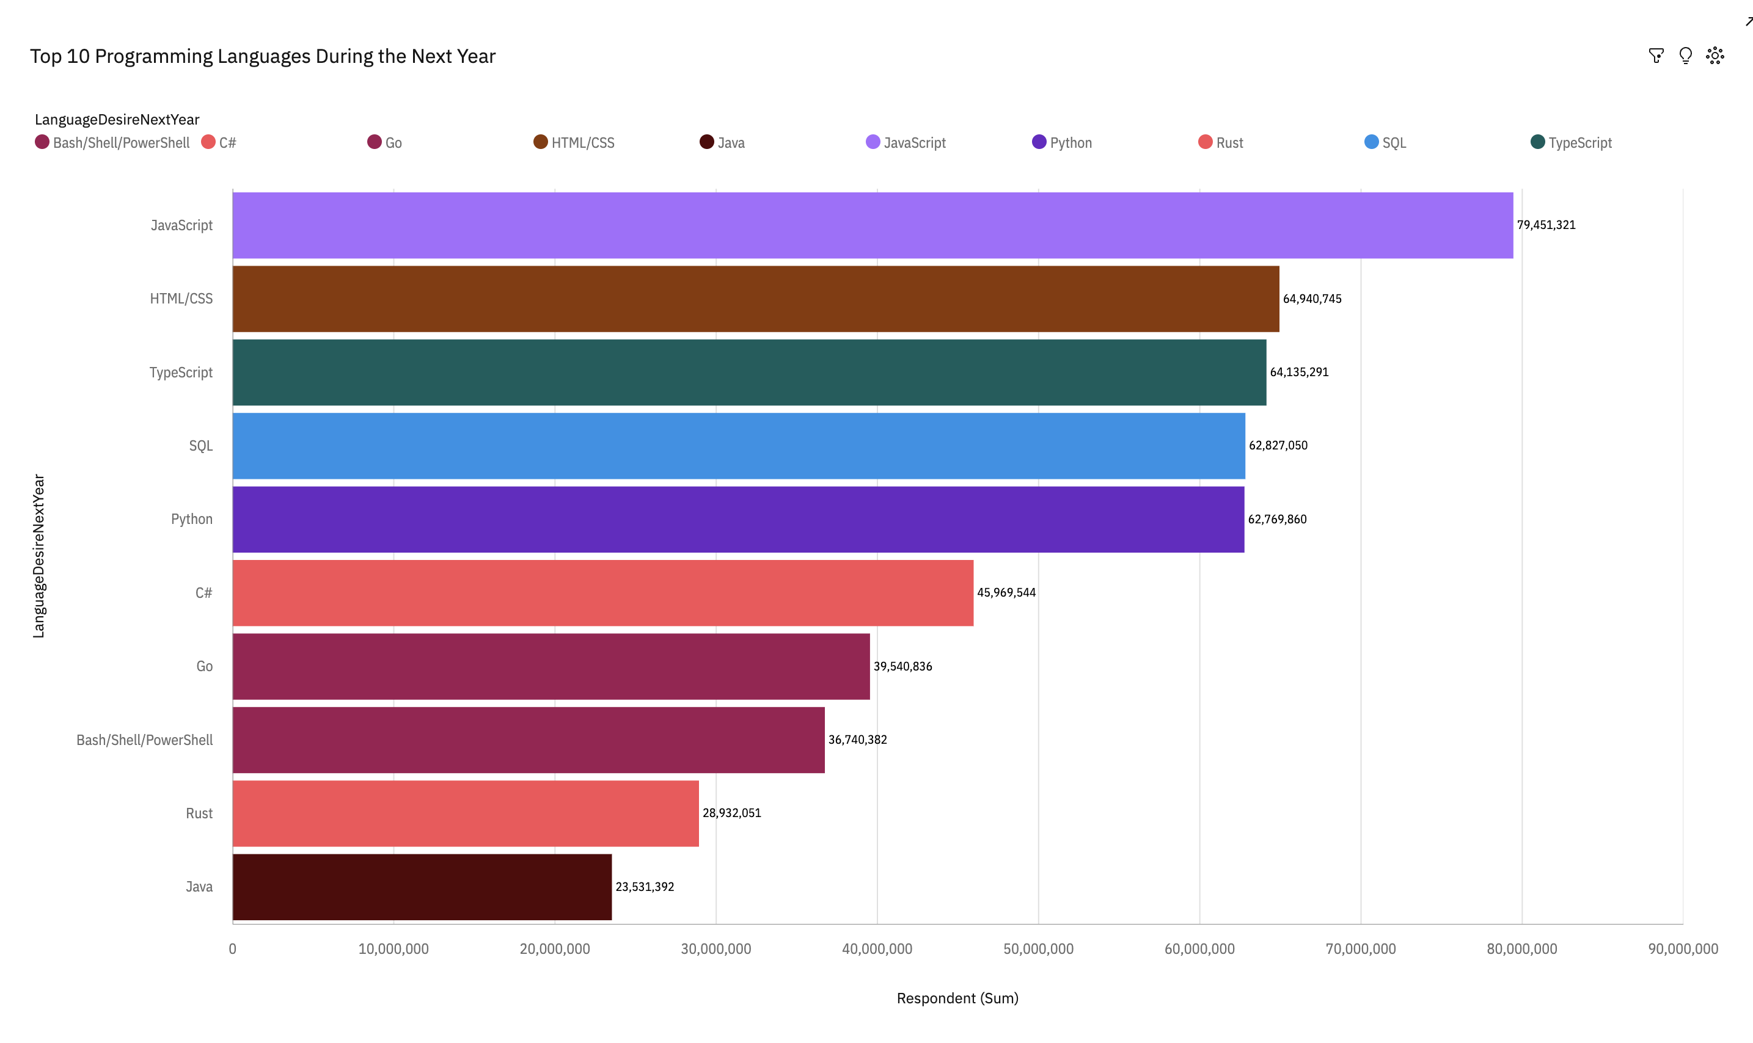
PROGRAMMING LANGUAGE TRENDS
Current Year
Next Year
<Bar chart of top 10 programming languages for the current year goes here.>
< Bar chart of top 10 programming languages for the next year goes here.>

Slide 13
PROGRAMMING LANGUAGE TRENDS - FINDINGS & IMPLICATIONS
Findings
More respondents have chosen Python and Typescript for next year in comparison to this year.
The choice of programming languages as priority during the next year has gone down drastically in respect of Bash/Shell/PowerShell, HTML/CSS, Java, JavaScript, SQL.
C++ and PHP are no more in the top 10 Programming Languages while Go which was not there among the top 10 in the current year has ranked 8th for next year. Rust has also entered the league.
Implications
Demand for both the languages viz. Python and Typescript will increase and may also lead to increase in the compensation for persons with these skills.
As the demand for these languages reduces the developers will go for skill upgradation by learning other languages whose demand is increasing.
Languages like Go and Rust will be the choice of many developers and initially the compensation may be high till more developers acquire the skills.

Slide 14
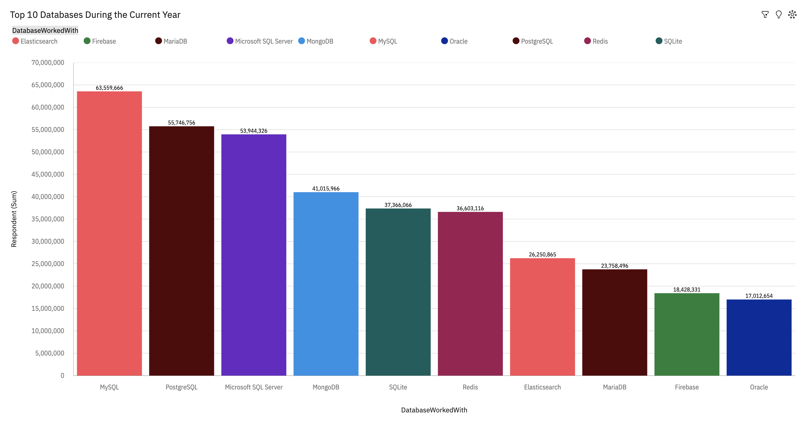
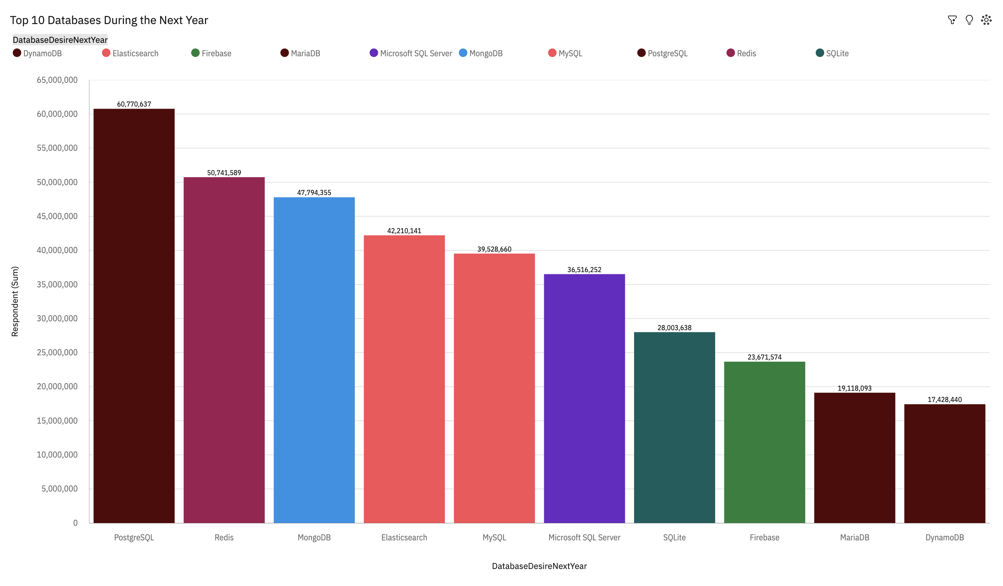
DATABASE TRENDS
Current Year
Next Year
< Bar chart of top 10 databases for the current year goes here >
< Bar chart of top 10 databases for the next year goes here.>

Slide 15
DATABASE TRENDS - FINDINGS & IMPLICATIONS
Findings
More respondents have chosen Elasticsearch, Firebase, MongoDB, PostgreSQL and Redis for next year in comparison to this year.
The choice of database as priority during the next year has gone down drastically in respect of Microsoft SQL Server, MySQL while moderately in case of MariaDB and SQLite.
Oracle is no more in the top 10 Database trending list while DynamoDB has entered the league.
Implications
Demand for the Databases viz. Elasticsearch, Firebase, MongoDB, PostgreSQL and Redis will increase and may also lead to increase in the compensation for persons with these skills.
As the demand for these Databases reduces the developers will go for skill upgradation by learning other Databases whose demand is increasing.
Databases like DynamoDB will be the choice of many developers and initially the compensation may be high till more developers acquire the skills.

Slide 16

DASHBOARD
Permanent link of the read-only view of the Cognos dashboard : https://ap1.ca.analytics.ibm.com/bi/?perspective=dashboard&pathRef=.my_folders%2FNew%2Bdashboard_Final%2BAssignment%2BPart%2BI%2BData%2BAnalytics%2Band%2BVisualisation%2BCapstone%2BProject&action=view&mode=dashboard&subView=model000001882054fec1_00000000

Slide 17
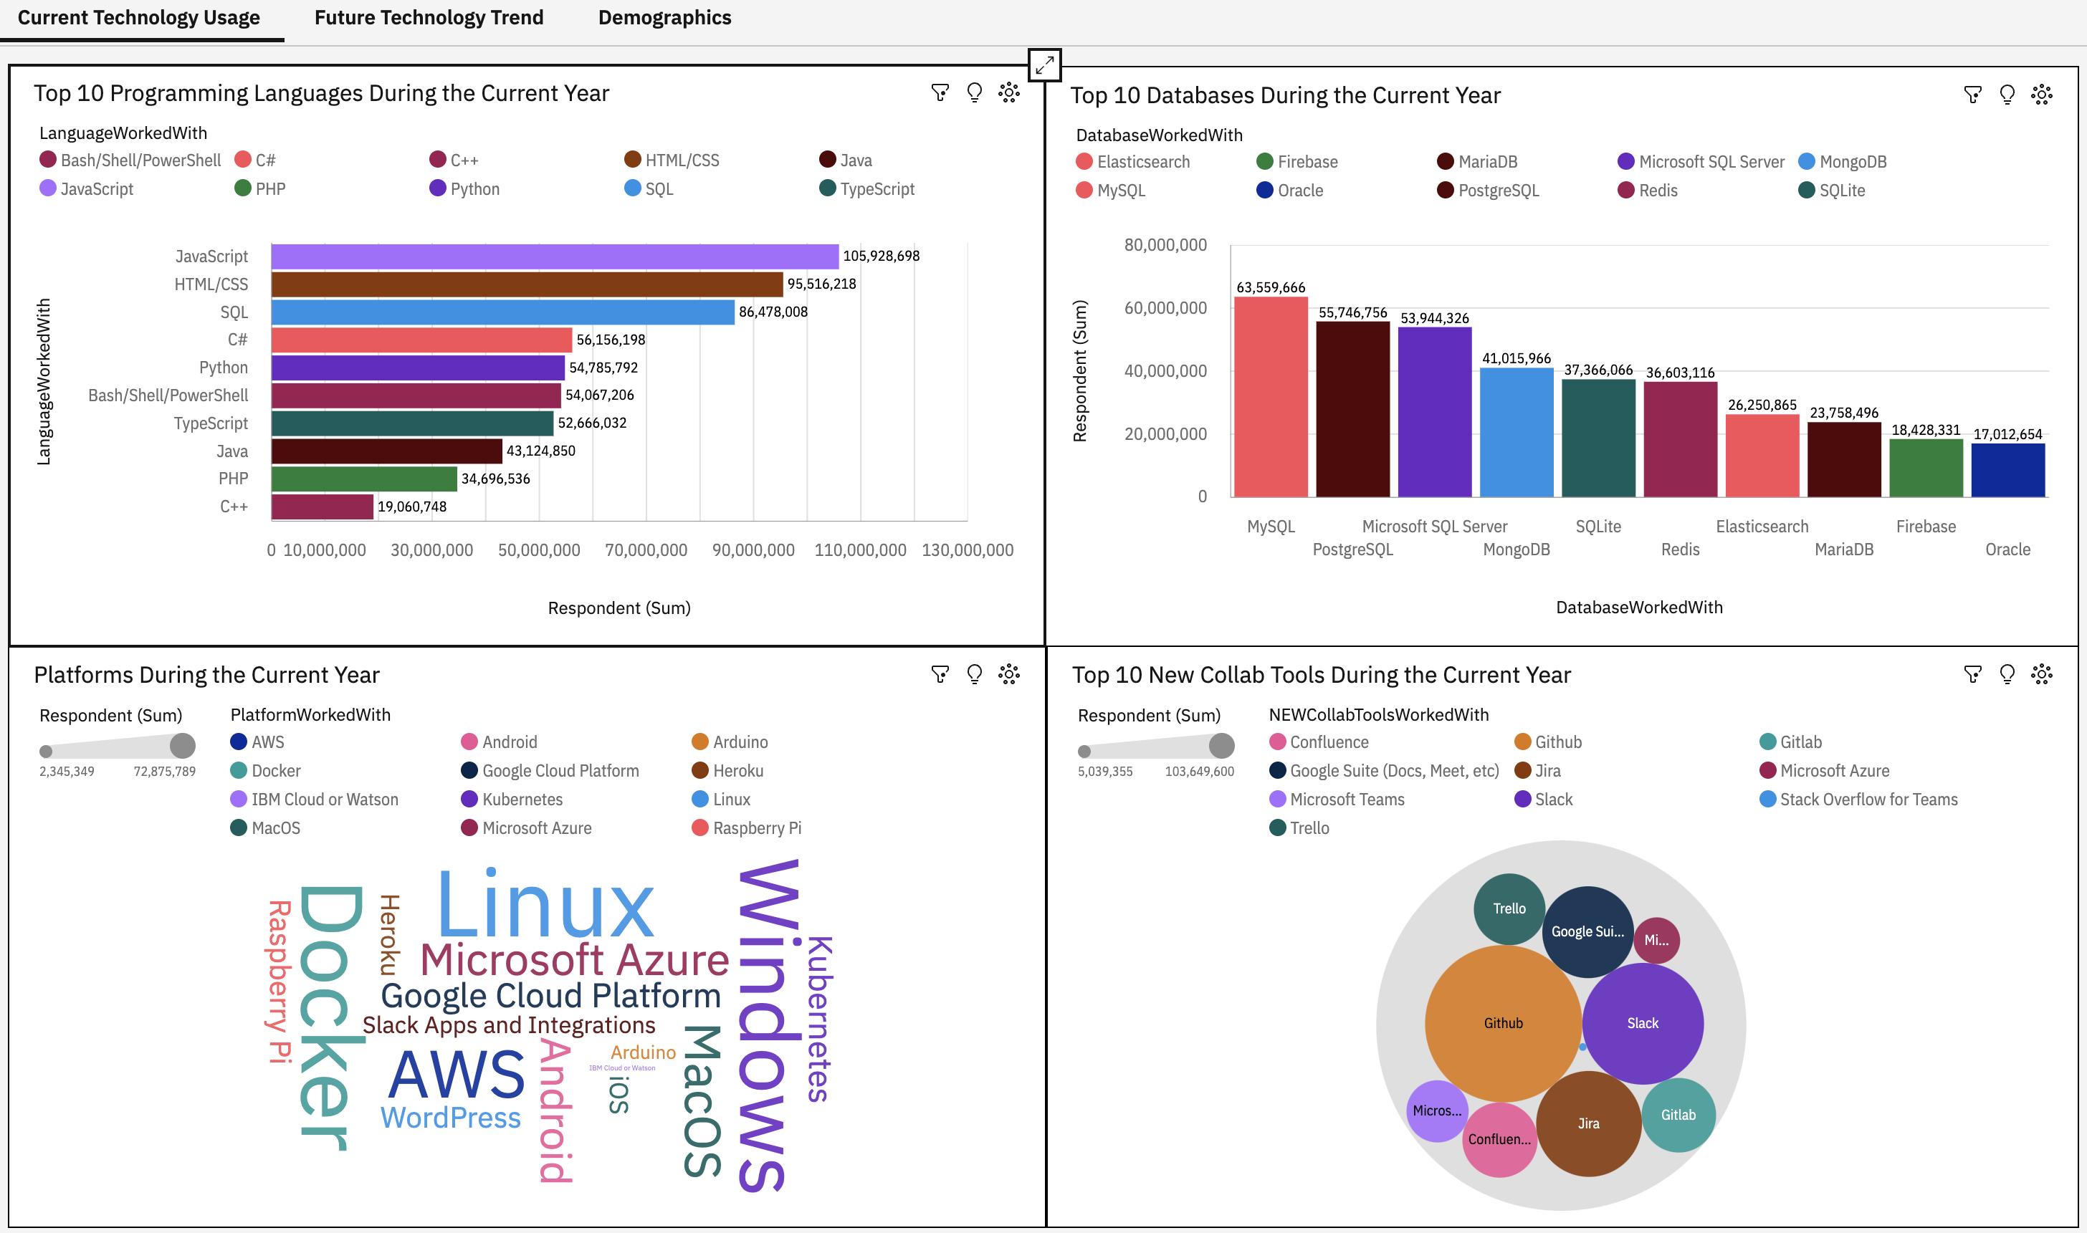
DASHBOARD TAB 1
Screenshot of dashboard tab 1 goes here

Slide 18
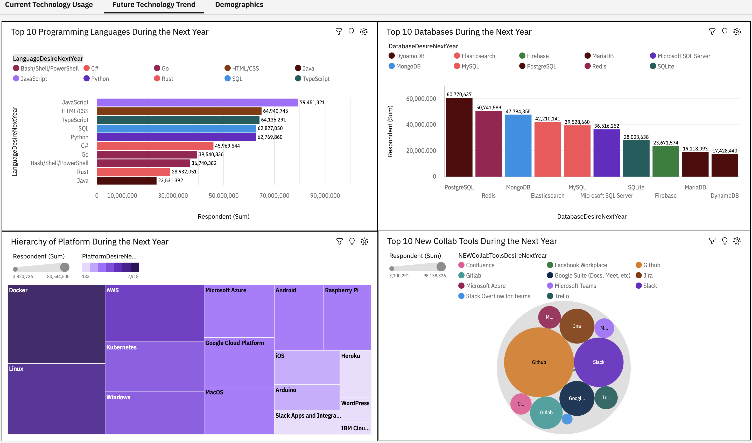
DASHBOARD TAB 2
Screenshot of dashboard tab 2 goes here

Slide 19
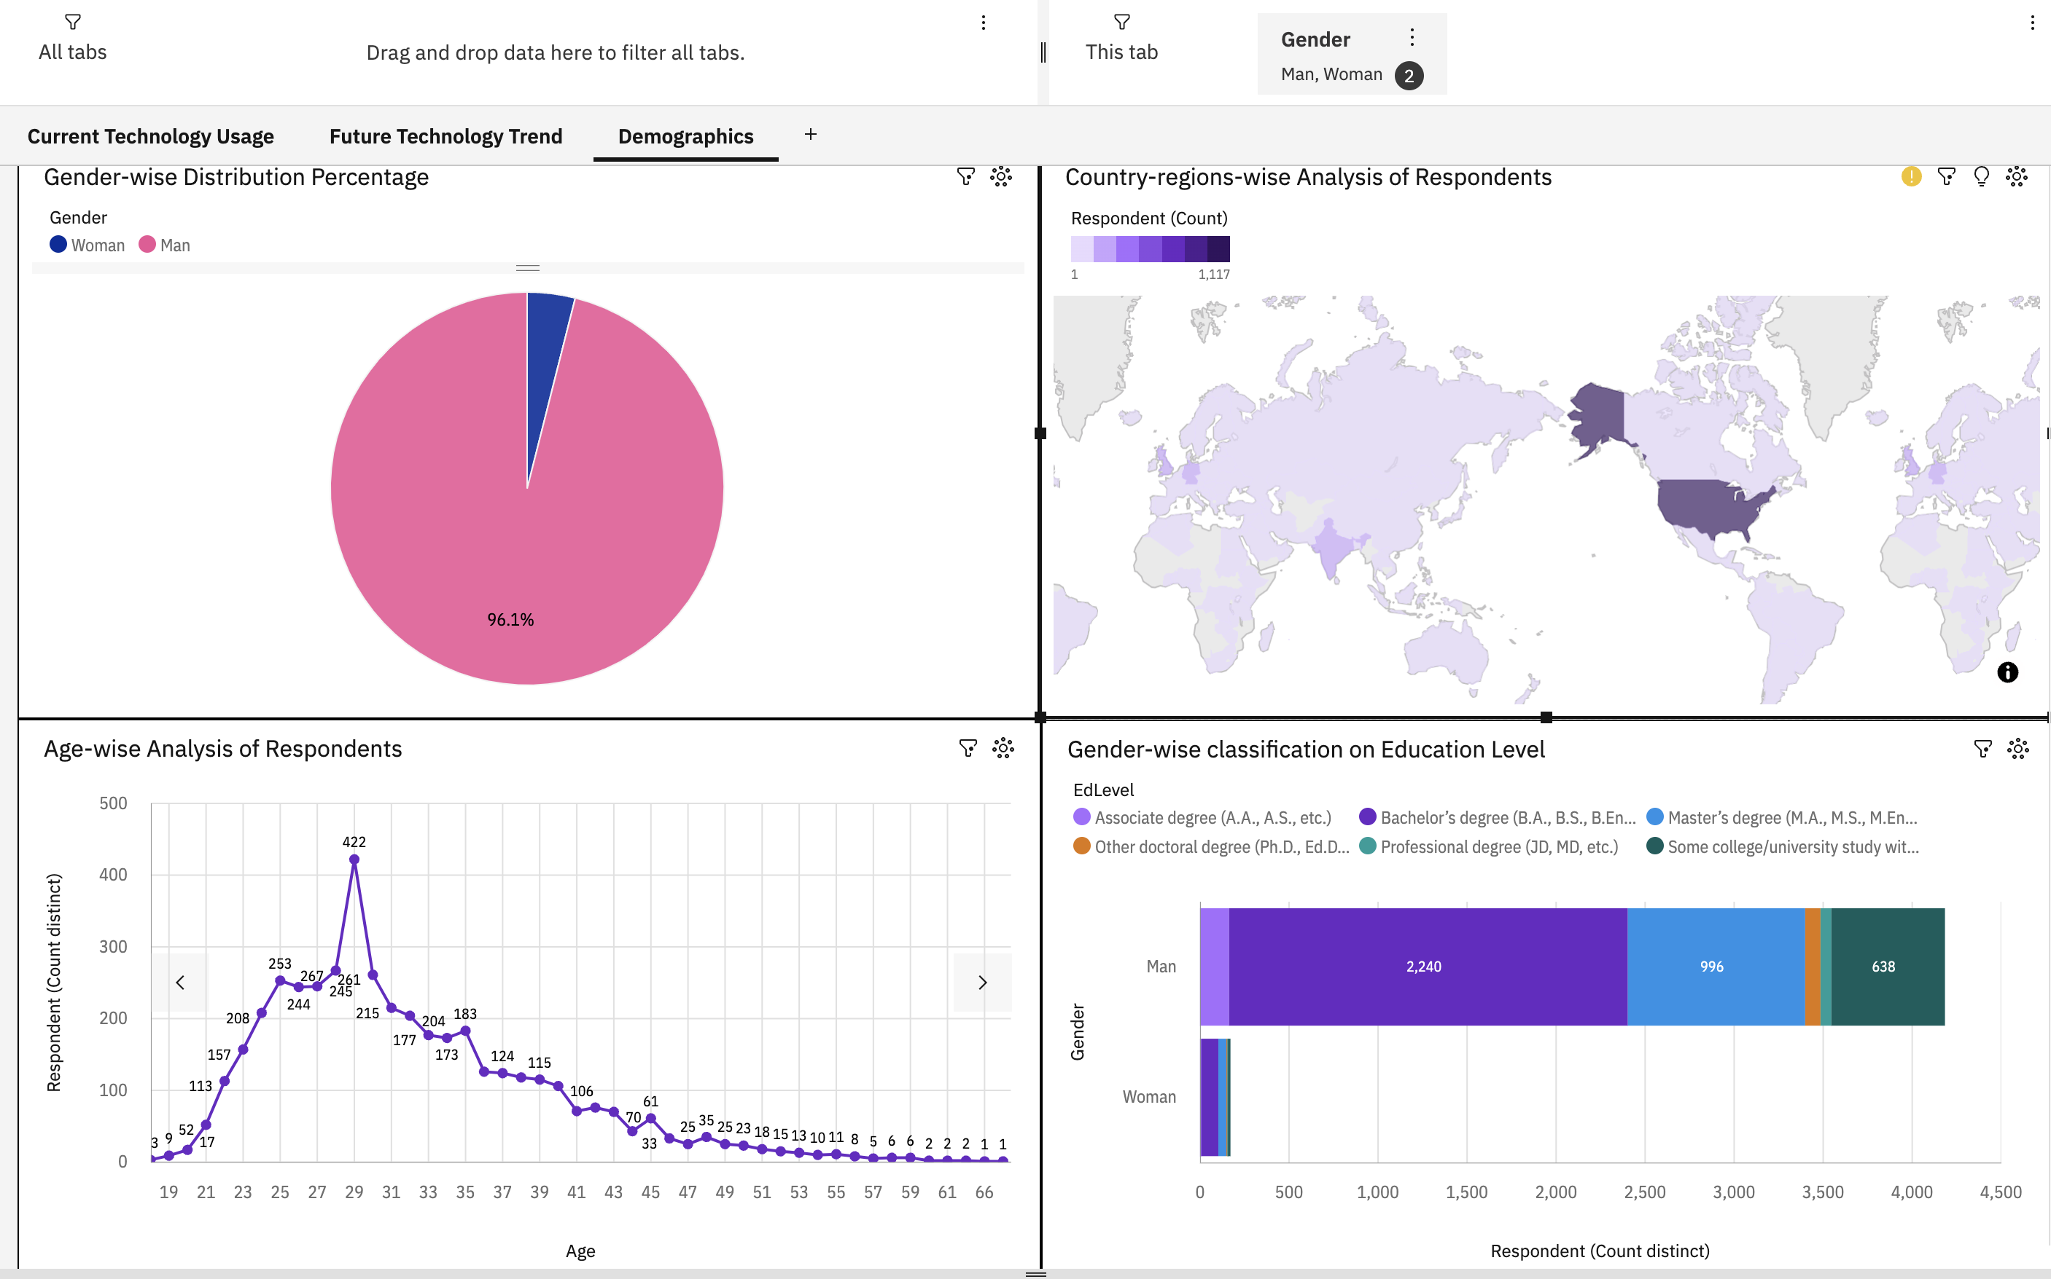
DASHBOARD TAB 3
Screenshot of dashboard tab 3 goes here

Slide 20
DISCUSSION
The survey data has thrown light on the current and immediate next year scenario in the area of:
>> Programming languages preferred by the developers
>> Databases preferred by the developers
>> Platforms preferred by the developers
>> Collaborative tools preferred by the developers
>> Variation in compensation based on programming language skills
>> Age of the majority group among developers.

Slide 21
OVERALL FINDINGS & IMPLICATIONS
Findings
Preference for some Programming languages are increasing among developers while for some it is decreasing.
Preference for some Databases are increasing among developers while for some it is decreasing.
Correlation between Age and compensation is Medium.
Maximum developers were in the age group 25 to 35.
Almost 90% of the respondents in the survey were men.
It is a normal distribution curve for salary based on the language skills with a narrow distribution.
Implications
Developers will upgrade their skills in the Programming languages that have increased preferences.
Developers will upgrade their skills in the Databases that have increased preferences.
Compensation is not related to Age is a stricter sense.
Majority of the developers belong to young age group with ability to acquire new skills.
Either the proportion of men is very high among the developers or women have preferred not to take part in the survey.
Variation of salary based on the language skills is not large.

Slide 22

CONCLUSION
At the beginning of the project, we defined the Problem for which we want to find answers. The problems are as under :
What are the top programming languages that are in demand ?
What are the top database skills that are in demand ?
What are the most popular Platforms ?
Demographic data like gender and age distribution of developers.
While answering the first three problems we will answer it from the perspective of future trends as the objective of the whole project is to identify future skill requirements.

Slide 23
CONCLUSION
Problem 1
What are the top programming languages that are in demand ?
Ans : The top ten programming languages in descending order are :
JavaScript, HTML/CSS, TypeScript, SQL, Python, C#, Go, Bash/Shell/PowerShell, Rust, Java
Problem 2
What are the top database skills that are in demand ?
Ans : The top ten databases in descending order are :
PostgreSQL, Redis, MongoDB, Elasticsearch, MySQL, Microsoft SQL Server, SQLite, Firebase, MariaDB, DynamoDB

Slide 24
CONCLUSION
Problem 3
What are the most popular Platforms ?
Ans : The top ten Platforms in descending order are :
Docker, Linux, AWS, Kubernetes, Windows, Microsoft Azure, Google Cloud Platform, MacOS, Android, iOS.
Problem 4
Demographic data like gender and age distribution of developers.
Ans : The demographic data based on the survey shows that almost 90% of the respondents in the survey were men and the maximum developers were in the age group 25 to 35.

Slide 25

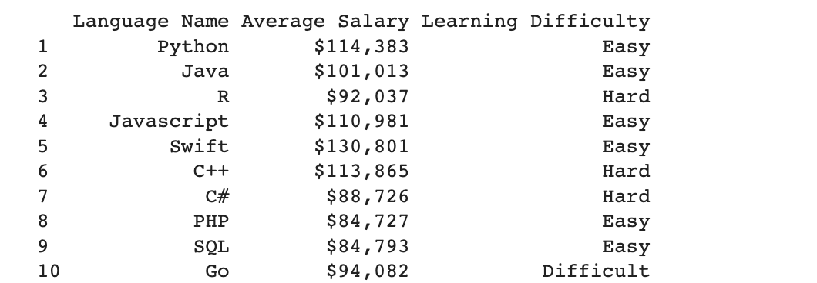
APPENDIX
Include any relevant additional charts, or tables that you may have created during the analysis phase.
Fig-1

Slide 26
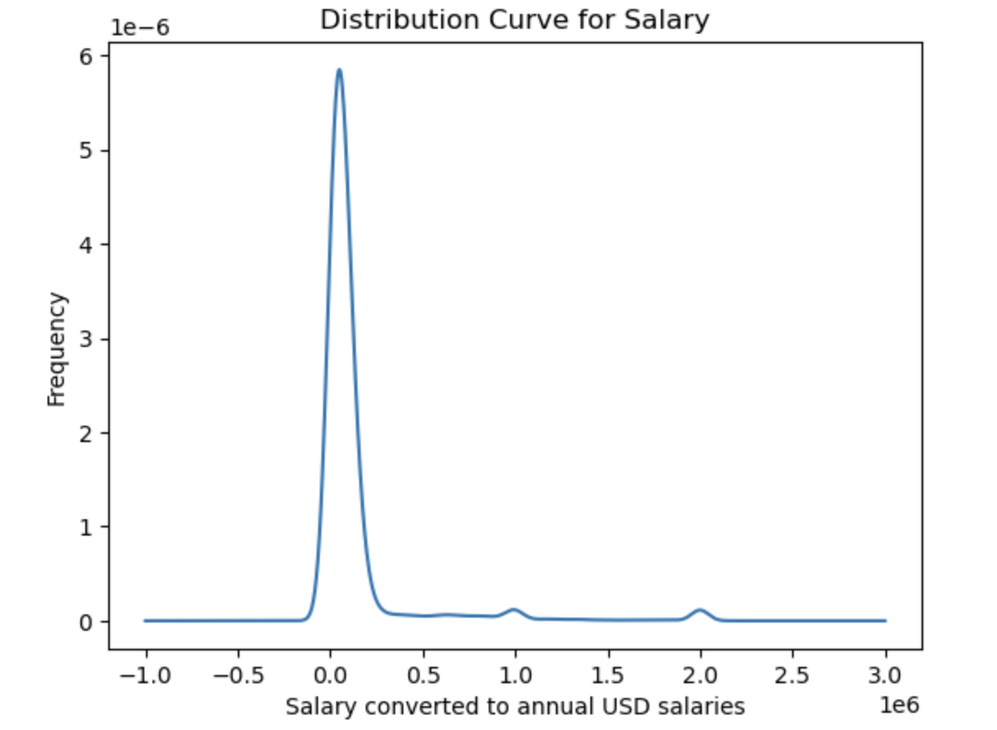
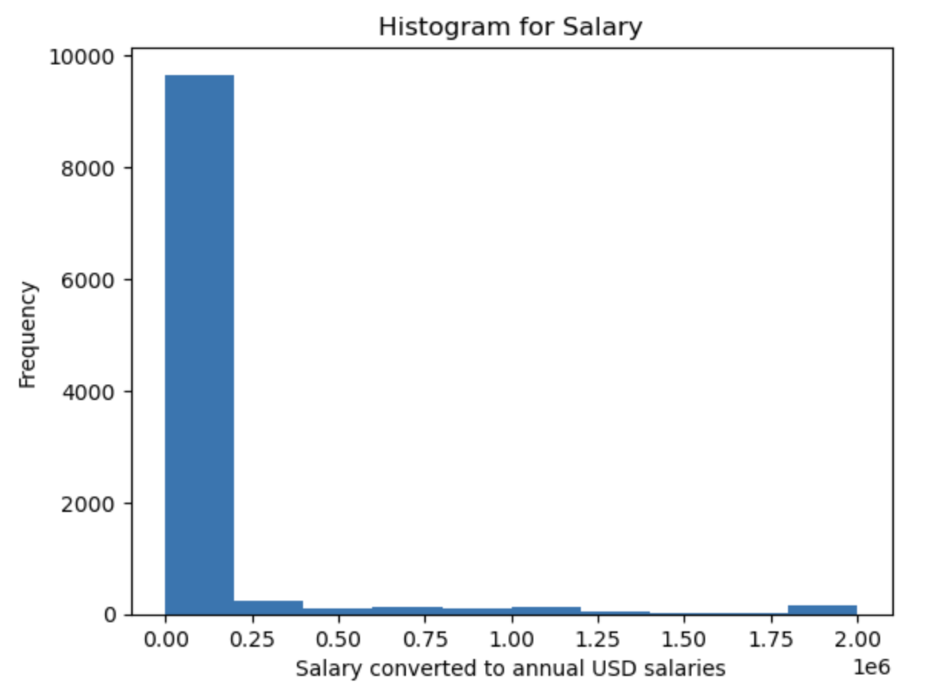
APPENDIX
Fig-2
Fig-3

Slide 27
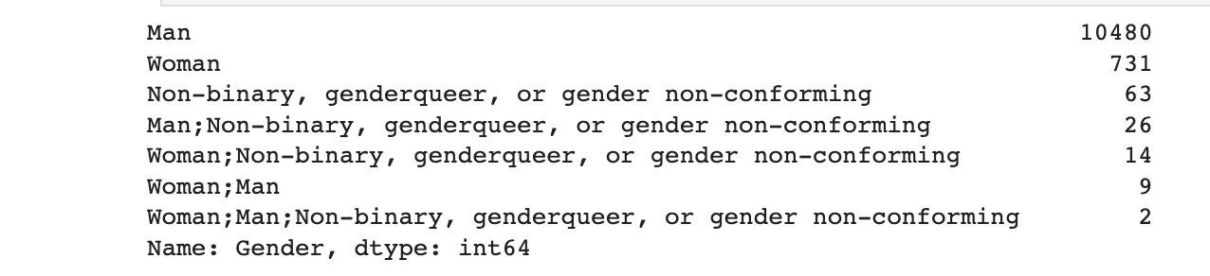
APPENDIX
Fig - 4
Fig - 5
What is the median of the column ConvertedComp ?
In [711:
# your code goes here
df [ 'ConvertedComp' ].median ()
Out [71]: 57745.0

Slide 28
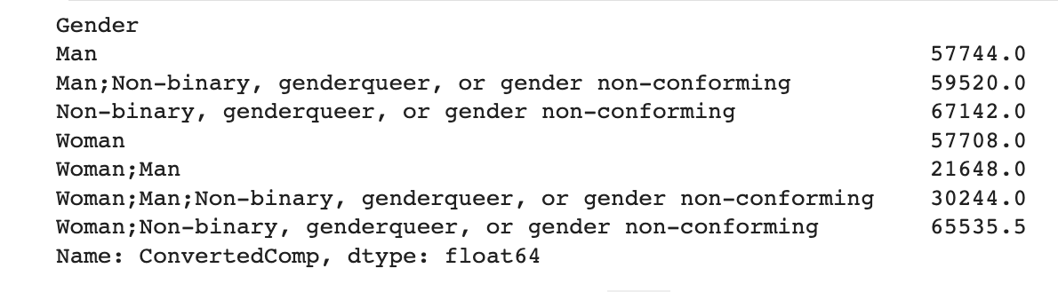
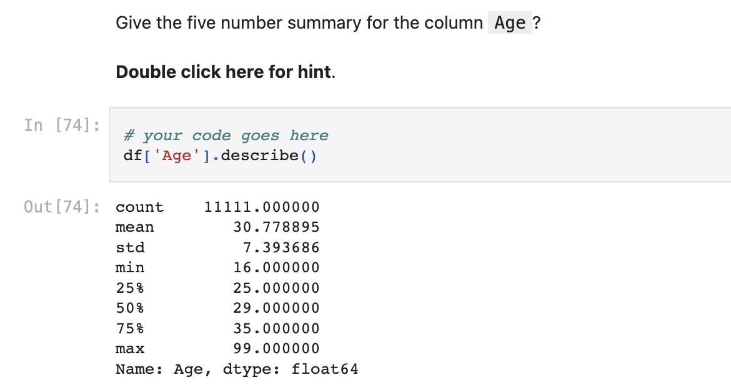
APPENDIX
Fig - 6
Fig - 7

Slide 29
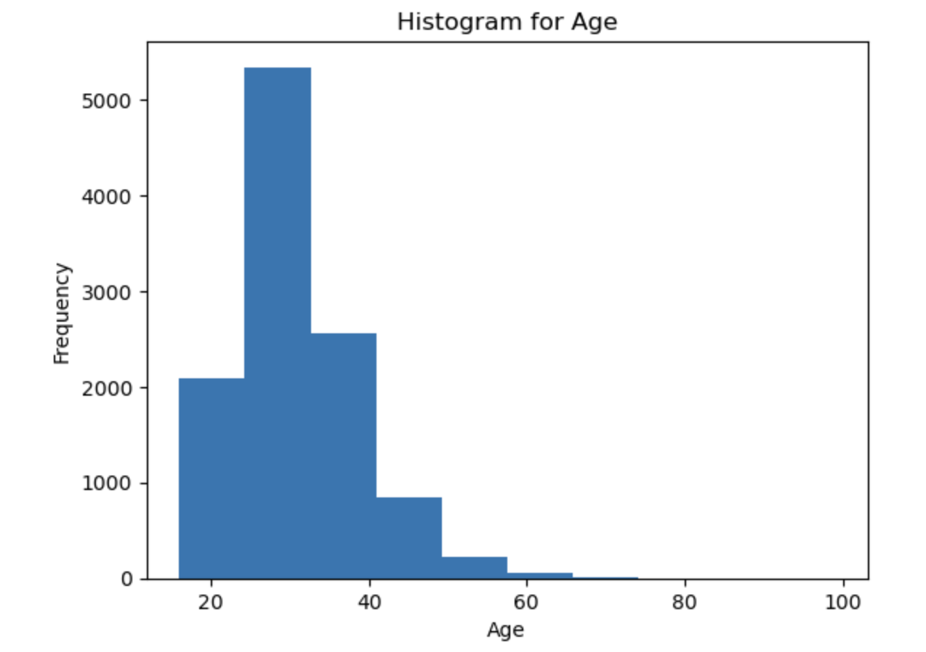
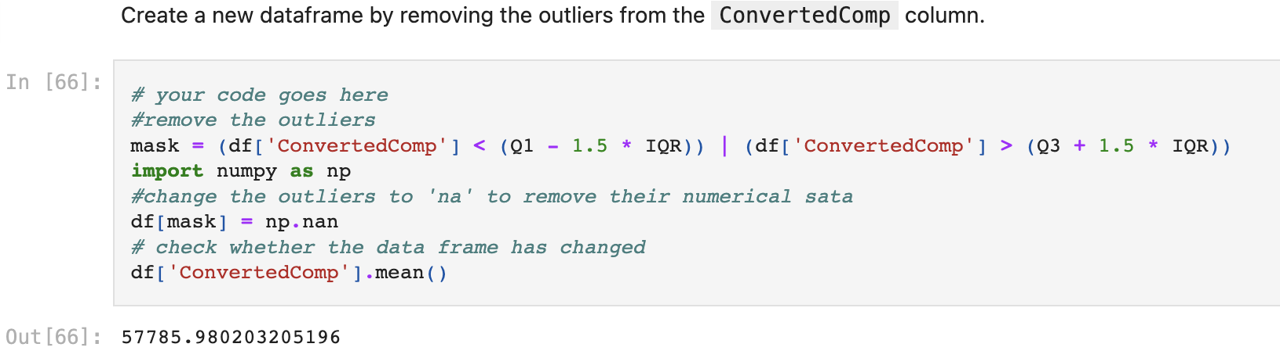
APPENDIX
Fig - 8
Fig - 9

Slide 30
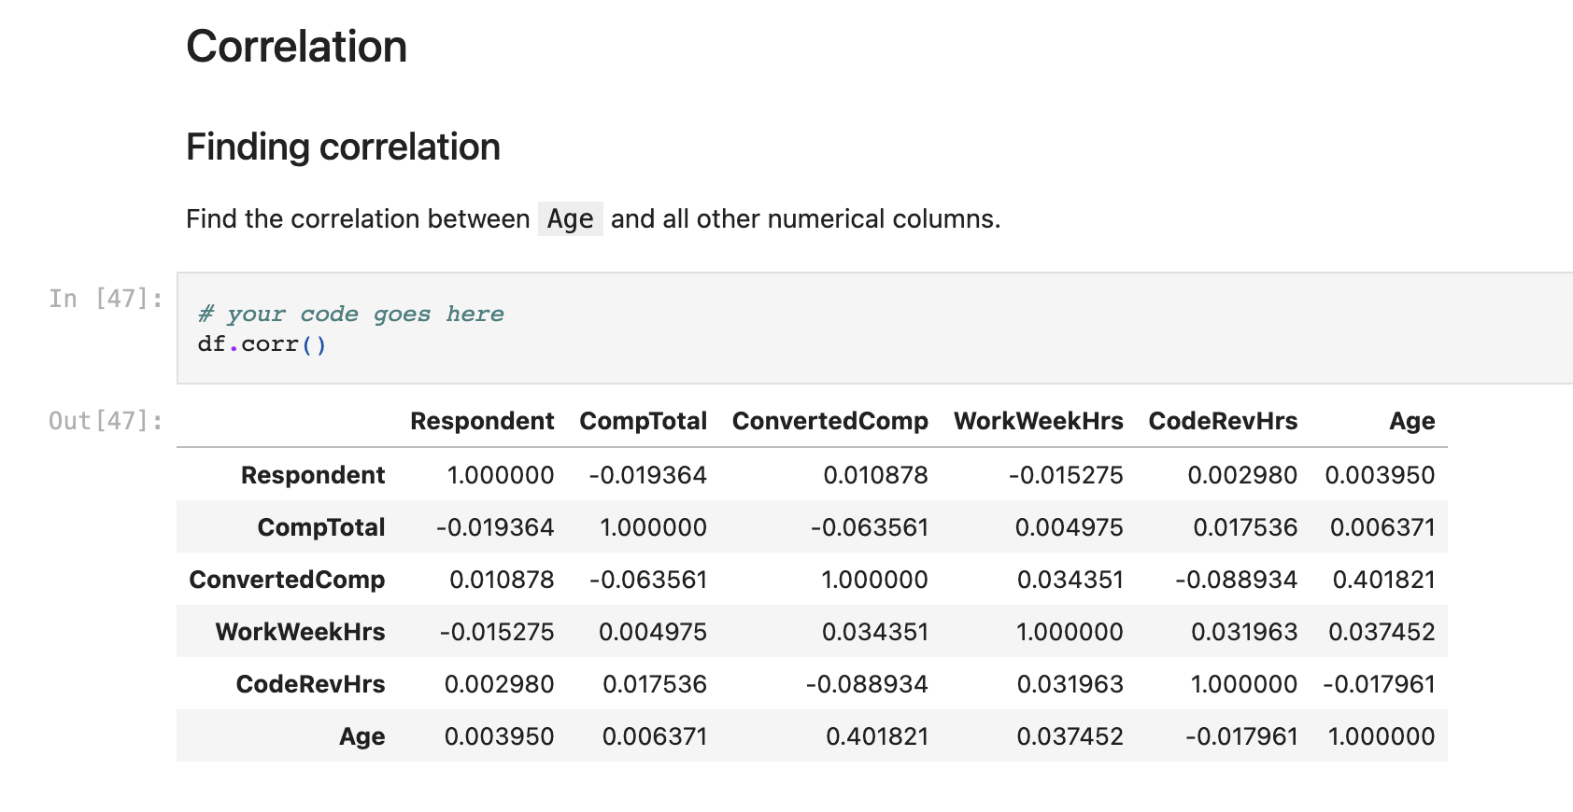
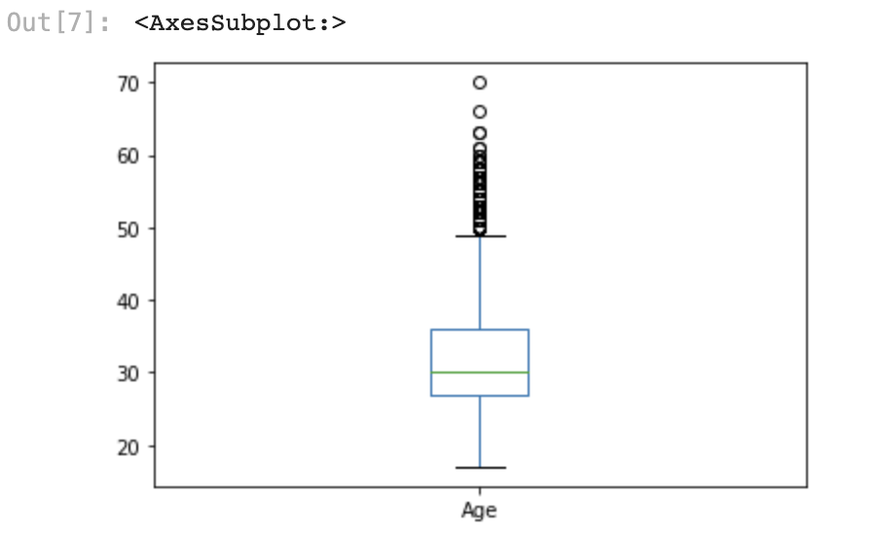
APPENDIX
Fig - 10
Fig - 11

Slide 31
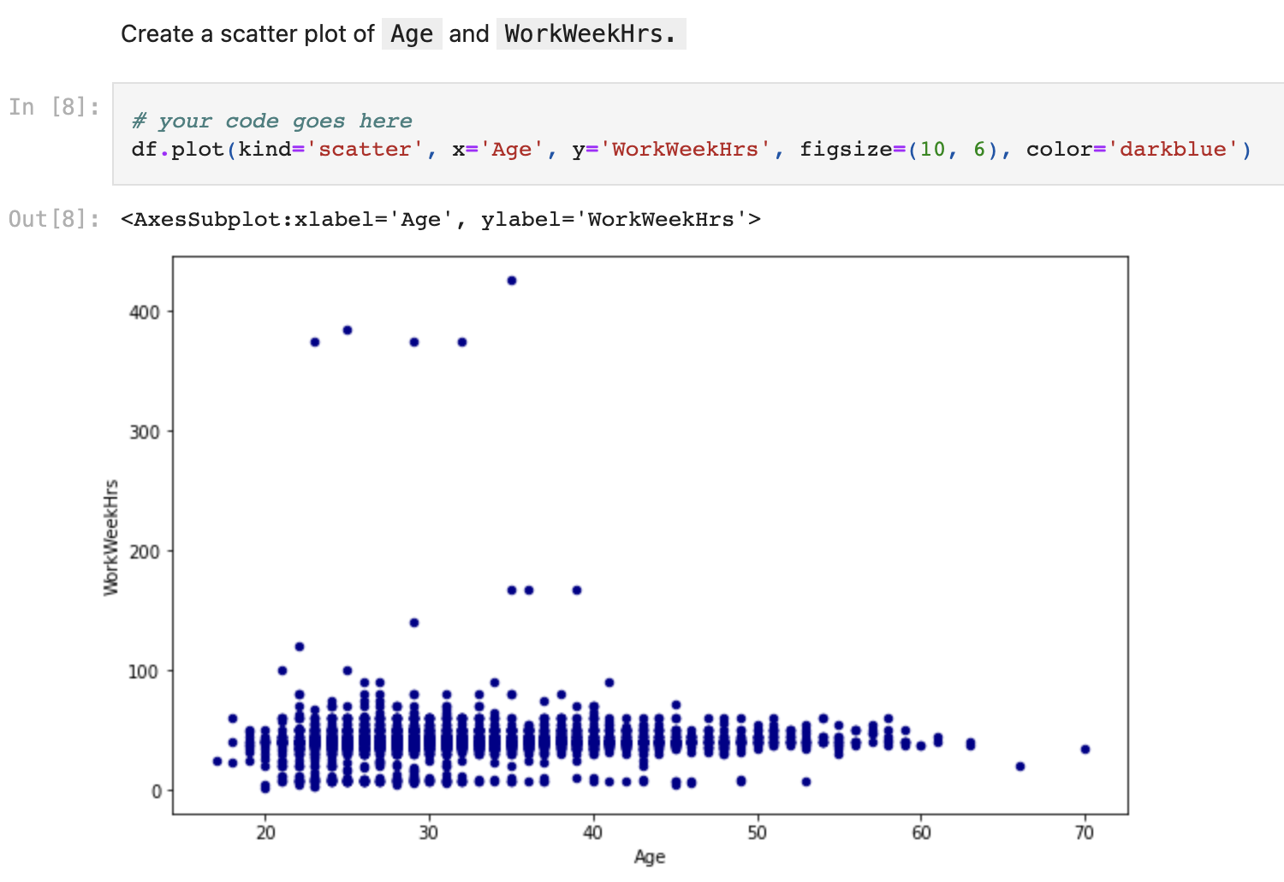
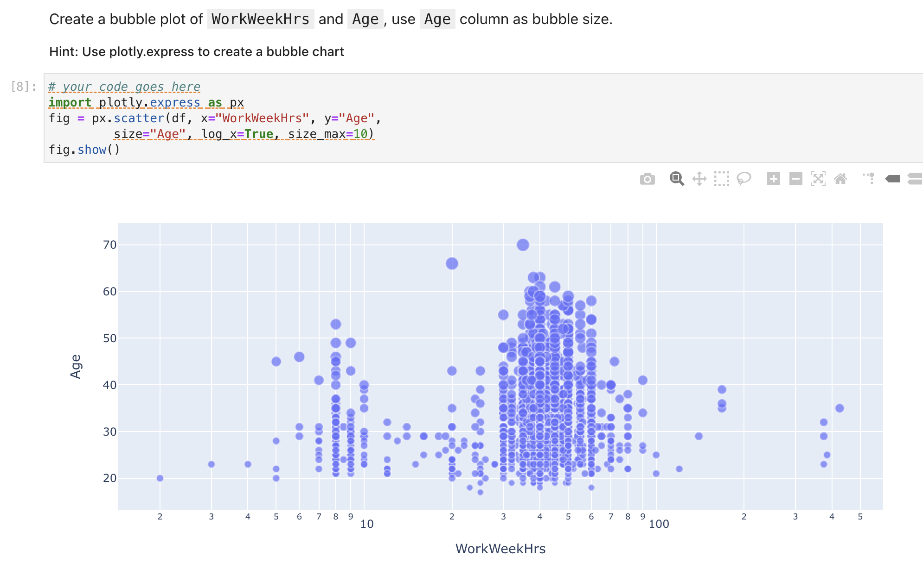
APPENDIX
Fig - 13
Fig - 12

Slide 32
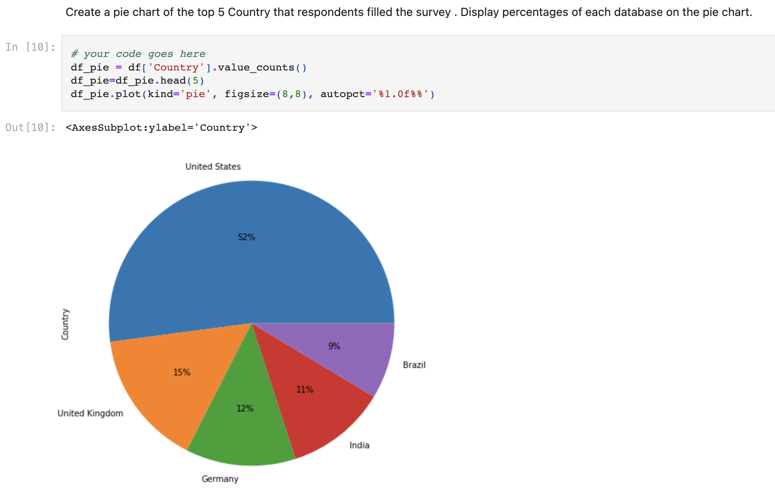
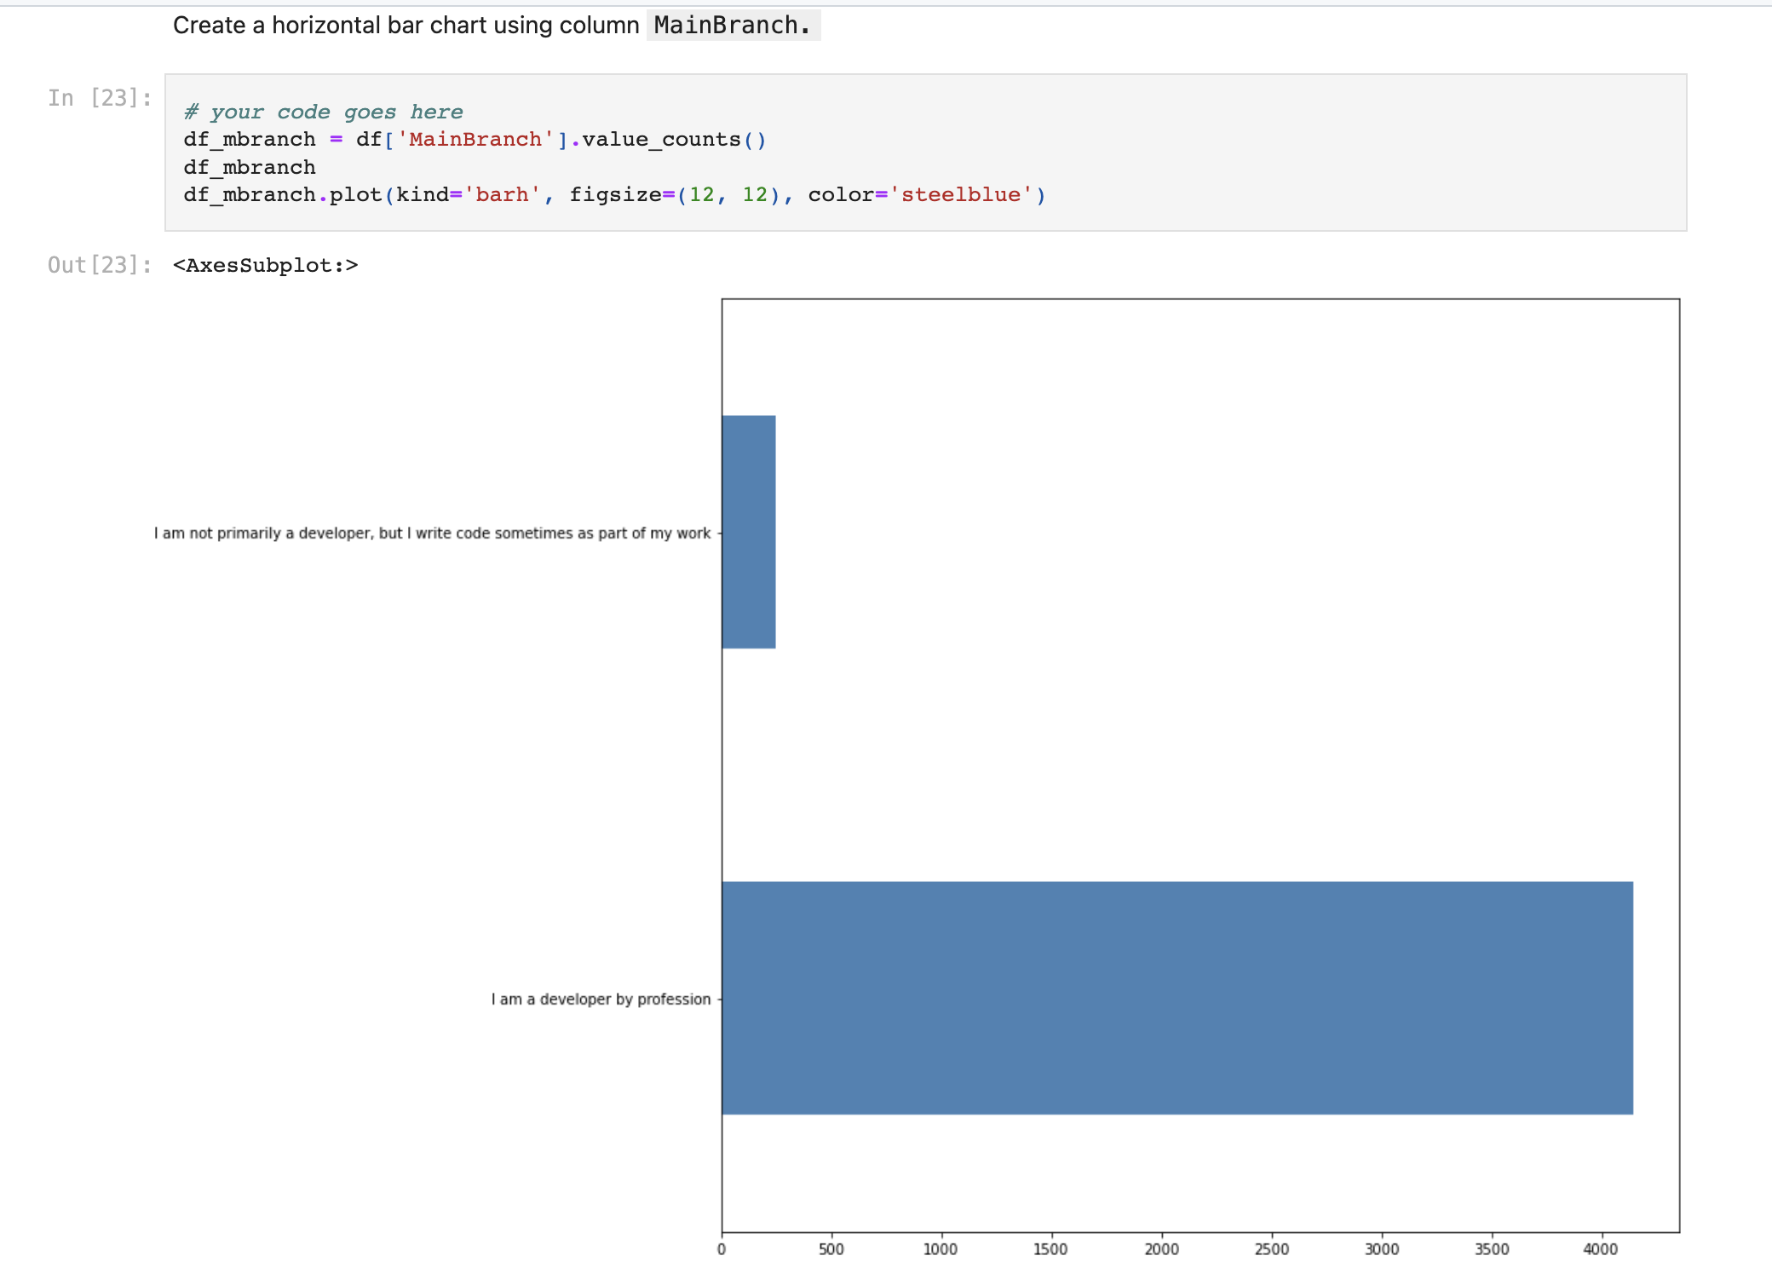
APPENDIX
Fig - 14
Fig - 15

Slide 33
JOB POSTINGS Bar chart of the number of jobs postings by technology (data collected in Module 1 using Job API in a file named “job-postings.xlsx”)

Slide 34
POPULAR LANGUAGES Bar chart of the Annual Average Salary by Language (data collected in Module 1 using web scraping in a file named “popular-languages.csv”)

